Slide 1
JAVASCRIPT
Intelligrape Softwares

Slide 2
AGENDA
What is JavaScript?
Introduction to DOM
Where To Write Javascript
Javascript Basics keywords and Syntax
Examples

Slide 3
What???
JavaScript is the most popular scripting language on the internet, and works in all major browsers, such as Internet Explorer, Firefox, Chrome, Opera, and Safari.

Slide 4
What and Why is JavaScript??
JavaScript was designed to add interactivity to HTML pages
JavaScript is a scripting language
JavaScript is usually embedded directly into HTML pages
JavaScript is an interpreted language (means that scripts execute without preliminary compilation)
Everyone can use JavaScript without purchasing a license

Slide 5
Is Java and JavaScript the same?
NO
Java is developed by Sun Microsystems(now Oracle) and is a full fledged language.
JavaScript is based on ECMA Script and is a scripting language.

Slide 6
What can a JavaScript do?
JavaScript gives HTML designers a programming tool - HTML authors are normally not programmers, but JavaScript is a scripting language with a very simple syntax! Almost anyone can put small "snippets" of code into their HTML pages
JavaScript can put dynamic text into an HTML page - A JavaScript statement like this: document.write("<h1>" + name + "</h1>") can write a variable text into an HTML page
JavaScript can react to events - A JavaScript can be set to execute when something happens, like when a page has finished loading or when a user clicks on an HTML element
JavaScript can read and write HTML elements - A JavaScript can read and change the content of an HTML element
JavaScript can be used to validate data - A JavaScript can be used to validate form data before it is submitted to a server. This saves the server from extra processing
JavaScript can be used to detect the visitor's browser - A JavaScript can be used to detect the visitor's browser, and - depending on the browser - load another page specifically designed for that browser
JavaScript can be used to create cookies - A JavaScript can be used to store and retrieve information on the visitor's computer
JavaScript can be used to create UI
AND MANY MORE......

Slide 7
Points to remember while writing javascript
Java like syntax
semicolon optional
case sensitive
runs on client machine
silently fails
Weakly typed

Slide 8
Introduction to DOM
DOM stands for Document Object Model
The DOM defines the objects and properties of all document elements, and the methods (interface) to access them.
In other words: The HTML DOM is a standard for how to get, change, add, or delete HTML elements.
According to the DOM, everything in an HTML document is a node.
The DOM says:
    The entire document is a document node
    Every HTML element is an element node
    The text in the HTML elements are text nodes
    Every HTML attribute is an attribute node
    Comments are comment nodes

Slide 9

DOM TREE Example

Slide 10
Where To And How To Include Javascript In Your File
There are 3 places where we can write JavaScript in our HTML Document
  In the Head
    <script type=”text/javascript”>{MyScript here}</script>
  In The Body
    <script type=”text/javascript”>{MyScript here}</script>
  In a separate file
    <script type=”text/javascript” src=”<path>”></script>
Each place has its own pros/cons, Lets Discuss
Remember JavaScript is Case Sensitive

Slide 11
Where to write javascript code
Anywhere in HTML document, better if written inside <Head> tag
<html>
<head>
<script type="text/javascript">
//code
var name=prompt("your name please : " , "(name)")
if(name){
alert("Your name is : "+name)
}else{
alert("You did not enter your name”)
}
</script>
</head>
<body>
</body>
</html>

Slide 12
Where to write javascript code cont...
Using External file
* write javascript code inside a .js file without enclosing in <script> html tag.
In case of Grails app store it in web-app/js/ directory.
* Now include the above file in head tag of HTML
<script type="text/javascript" src="yourfile.js"></script>
In case of Grails app use grais resource tag or grails javascript tag to include the js file like :
<script type=”text/javascript” src=”${resource(dir:'js', file:'yourfile.js')}”

Slide 13
Intro To JavaScript!!
Lets First Develop a sample Project. This is where we will be doing all our examples.
On your Desktop make a directory “JSProject” and create two empty files in it “index.html” and “application.js”
  Bash Command:
    cd ~/Desktop; mkdir JSProject;cd JSProject; touch index.html application.js

Slide 14
Document.write()
It is used to write text on the document.
Example:
    <html>
    <body>
    <h1>My First Web Page</h1>
    <script type="text/javascript">
    document.write("<p>" + Date() + "</p>");
    </script>
    </body>
    </html>

Slide 15
JavaScript Variables
Same as algebra, JavaScript variables are used to hold values or expressions.
A variable can have a short name, like x, or a more descriptive name, like carname.
Rules for JavaScript variable names:
    Variable names are case sensitive (y and Y are two different variables)
    Variable names must begin with a letter or the underscore character
Note: Because JavaScript is case-sensitive, variable names are case-sensitive.

Slide 16
Example
var x=5;
var carname="Volvo";
y=x-5;
z=y+5;
Etc..

Slide 17
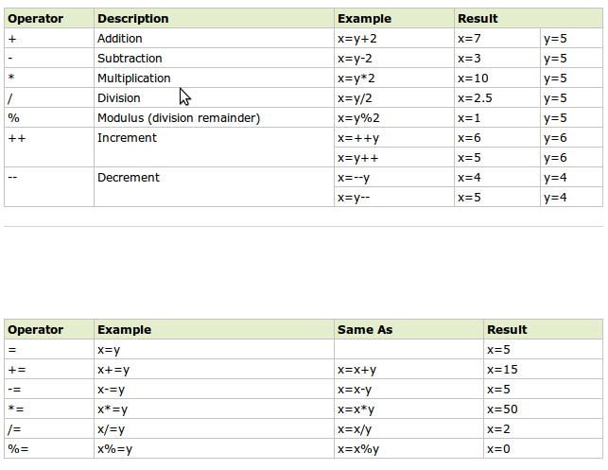
JavaScript Operators

Slide 18
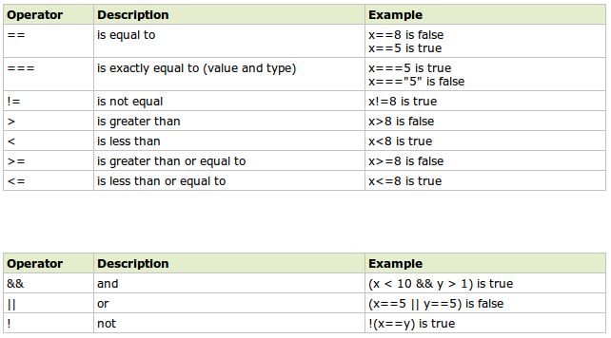
JavaScript Comparators

Slide 19
JavaScript If...Else Statements
Javascript supports if,if else, else statements.
    <script type="text/javascript">
    //If the time is less than 10, you will get a "Good morning" greeting.
    //Otherwise you will get a "Good day" greeting.
    var d = new Date();
    var time = d.getHours();
    if (time < 10)
    {
    document.write("Good morning!");
    }
    else
    {
    document.write("Good day!");
    }
    </script>

Slide 20
JavaScript Switch Statement
JavaScript Supports Switch Statement
    <script type="text/javascript">
    //You will receive a different greeting based
    //on what day it is. Note that Sunday=0,
    //Monday=1, Tuesday=2, etc.
    var d=new Date();
    var theDay=d.getDay();
    switch (theDay){
    Case 5: document.write("Finally Friday");
    break;
    Case 6: document.write("Super Saturday");
    break;
    Case 0: document.write("Sleepy Sunday");
    break;
    Default: document.write("I'm looking forward to this weekend!");
    }
    </script>

Slide 21
JavaScript Popup Boxes
Three types of boxes:
  Alert Box
    alert("sometext");
  Prompt Box
    var name = prompt("Please enter your name","Harry Potter");
  Confirm Box
    var r = confirm("Press a button"); return: [true/false]

Slide 22
Functions
A function contains code that will be executed by an event or by a call to the function.
You may call a function from anywhere within a page (or even from other pages if the function is embedded in an external .js file).

Slide 23
Fuctions Cont...
function displaymessage(){
alert("Hello World!");
}
function product(a,b){
return a*b;
}
function sumArray(arr){
var sum=0;
for(counter in arr){
sum+=arr[counter]
}
return sum;
}

Slide 24
Exercise
In Application.js Make a function which returns the current date/time.
Also make another function which returns the Date passed in a defined format.(dd Month, yyyy HH:MM:ss)

Slide 25
JavaScript For Loop
Same as we Do in C/C++
    <html>
    <body>
    <script type="text/javascript">
    var i=0;
    for (i=0;i<=5;i++)
    {
    document.write("The number is " + i);
    document.write("<br />");
    }
    </script>
    </body>
    </html>

Slide 26
Events
Events are actions that can be detected by JavaScript.
Every element on a web page has certain events which can trigger a JavaScript.
We define the events in the HTML tags.
Events are normally used in combination with functions, and the function will not be executed before the event occurs!

Slide 27
Events Continued ...
The onLoad and onUnload events are triggered when the user enters or leaves the page.
    <body onload="myFuction()"></body>
The onFocus, onBlur and onChange events are often used in combination with validation of form fields.
    <input type="text" size="30" id="email" onchange="checkEmail()">
The onSubmit event is used to validate ALL form fields before submitting it.
    <form method="post" action="xxx.htm" onsubmit="return checkForm()">
OnMouseOut
OnMouseOver
OnChange
keypress

Slide 28
Try/Catch
    try
    {
    //Run some code here
    }
    catch(err)
    {
    //Handle errors here
    }

Slide 29
TIP: Break up a Code Line
document.write("Hello \
World!");
document.write \
("Hello World!");

Slide 30
Built-in Javascript Objects
String
Date
Array
Math
more....

Slide 31
String Object methods
toLowerCase()
toUpperCase()
replace()
IndexOf()
trim()
charAt(index)
e.g.
Var upper="Hi Hello".toUpperCase()
Var len="Some".length
alert(upper.toLowerCase())
Var wordsArray=upper.split()

Slide 32
Math Class
Math.round(12.56)
Math.max(4,7)
Math.min(5,6)
Math.sqrt(2)
Math.random()
Math.PI
Math.E

Slide 33
DOM manipulation
Var selectBox=document.getElementById("mySelect");
Var textEntered=document.getElementsByName('q')[0].value="123";

Slide 34
Exercise 2
Make A Function which takes the “ID”, of the element and “HTML” as the parameter, And replaces the content of the element by the HTML supplied.
Make a “div” on the Html Page with id=”timeDisp”. Write a function which uses all the functions developed in previous exercises to display current formatted time in the “div” crated above.

Slide 35
JavaScript Objects
Earlier in this tutorial we have seen that JavaScript has several built-in objects, like String, Date, Array, and more. In addition to these built-in objects, you can also create your own.
An object is just a special kind of data, with a collection of properties and methods.
Ex:
personObj=new Object();
personObj.firstname="John";
personObj.lastname="Doe";
personObj.age=50;
personObj.calc= function(){};

Slide 36
Exercise 3
Create an Object named Clock and encapsulate all functions in it.

Slide 37
Intervals
You can create an Interval
    setInterval(“script”,time in mills)
You can erase an interval.
    clearInterval(intervalProcessId)

Slide 38
Exercise 4
Make an Interval which calls the method updateTime every one second.
Make a button which can stop this interval.

Slide 39
Useful links
http://www.w3schools.com/js/js_intro.asp
http://www.w3schools.com/quiztest/quiztest.asp?qtest=JavaScript

Slide 40
Final Exercise
1) Prompt for amount, interest rate and no. of years and calculate simple interest.
2) is palindrome string
3) Area of circle
Exercises Using Form
1) On click of a button ask for the name of user and display it inside the text box
2)
Copy text of one text field to another on change of text in first text box
3) Allow submission of form only if the user has entered his name(not empty) and age is greater than or equals to 18
4) Externalize javascript file
4) Change color of the div when mouse is moved over it and restore the color when mouse moves out of it

